Slide 1











PLAYER 1
HIGHSCORE 2500
PLAYER 2
AR SCAVENGER HUNT

Slide 2







01
07
12
Introduction
This AR treasure hunt game is a multiplayer, interactive experience that combines learning with fun. Players solve clues, explore real locations, and compete for top ranks.

Slide 3
Game Flow
Players receive clues leading to AR markers in physical locations.
Upon scanning an AR marker, they encounter a puzzle to solve.
Successful completion unlocks the next clue, guiding players to the subsequent AR marker.
A ranking system tracks players progress

Slide 4
Game Play Video

Slide 5
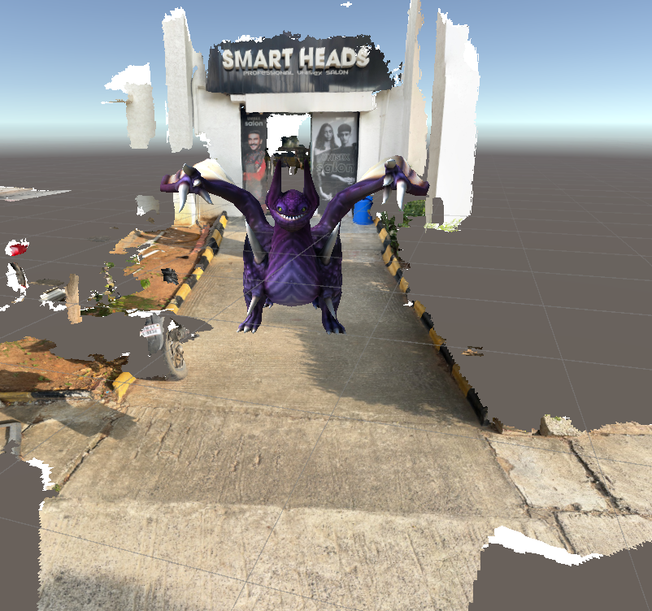

How?
Created 3D models of area with Vuforia Creator
Imported the 3D model into Unity and place AR objects (Added Script upon clicking loads the next scene)
Added a Vuforia AR Camera in Unity to enable AR tracking and recognize physical surroundings.

Slide 6
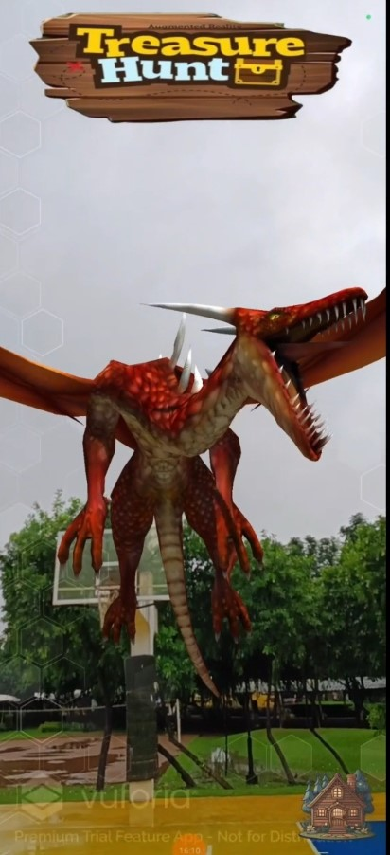
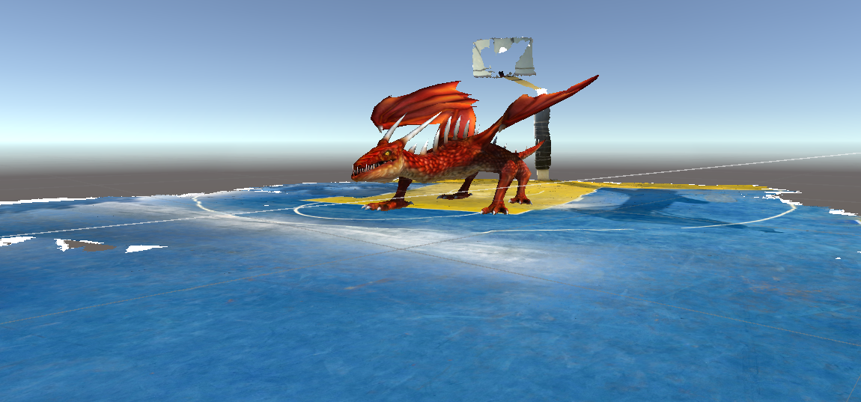

Slide 7
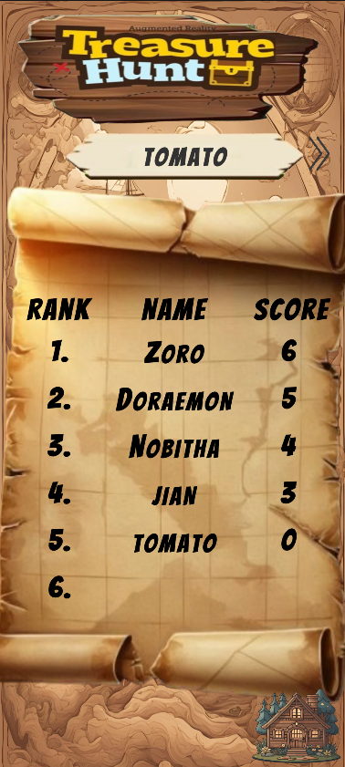

Leaderboard
Utilized a self-hosted version of a score server to manage and track player rankings easily.
Leader Creator provides an API, making it simple to integrate leaderboard functionality directly within the game.
This asset Generates public and private keys to securely connect game to the leaderboard, ensuring data integrity and access control.

Slide 8
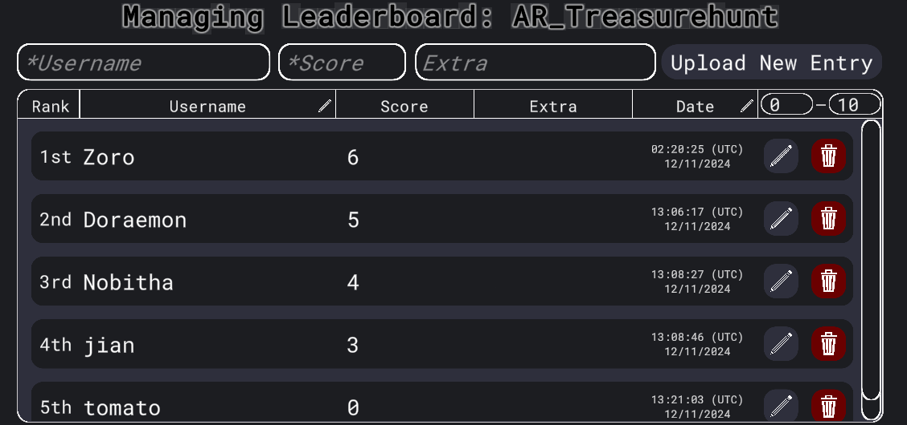
Leaderboard

Slide 9
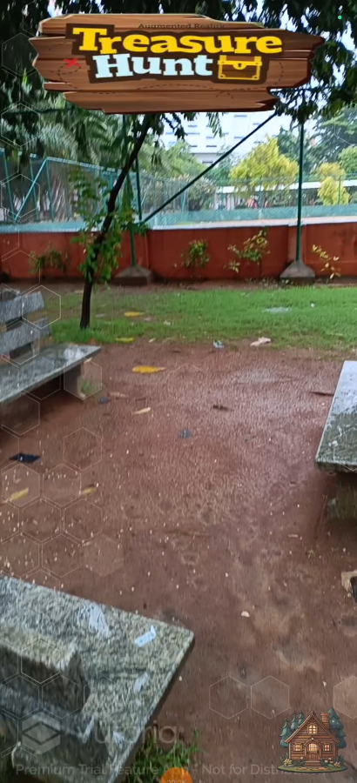
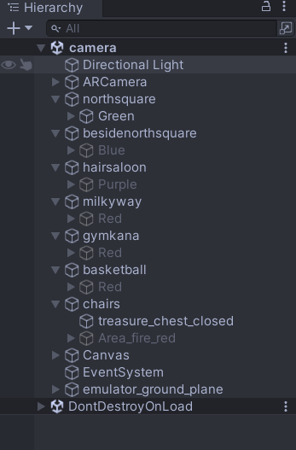
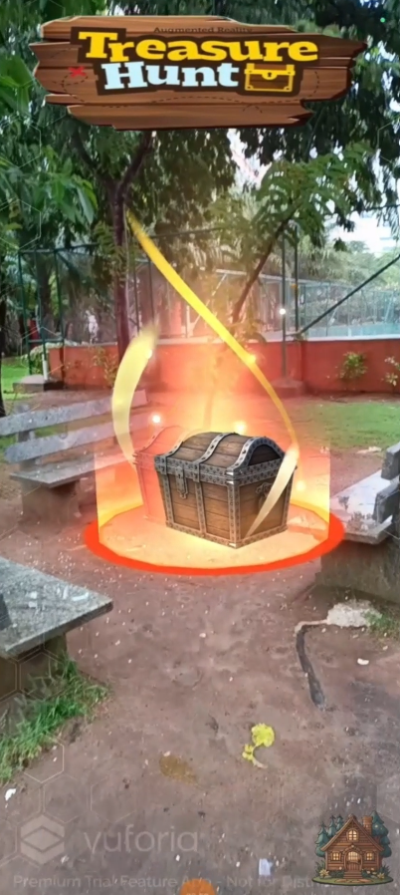
next level remains locked until previous level is completed.
Hidden until previous level is completed

Slide 10
01
07
12
Future Scope and Selling Points
To use GPS-Based AR Markers instead of 3D models, allowing for easier, location-based gameplay without needing to recreate environments.
Ideal for college events and competitions, adding excitement to learning
Perfect for educational platforms like Byju’s, enabling student competitions where solving problems unlocks the next clue, making learning engaging and fun.

Slide 11
Thank You

